Slide 1
THE EDUCATION RIGHTS OF SPECIAL NEEDS CHILDREN
Attorney Keith Howard, Esq.
The Law Offices of Keith L. Howard, PLLC
1-704-612-4151
We advocate for parents and children throughout the State of North Carolina!

Slide 2
Agenda
Keith Howard’s Bio
Special Education
Questions

Slide 3
ABOUT ME!
Former Education Law Professor
13 years of legal advocacy experience
Social Justice Advocate
Poverty Law Attorney
Husband, father, and dedicated teacher and coach.
Personal Motto: “It’s easier to build strong children than to repair broken men [and women].” Frederick Douglass

Slide 4
Key Definitions
Short-Term Suspension
Expulsion
Zero-Tolerance Policies
IEP
Manifestation Determination Review
EOG/EOC
Long-Term Suspension
FBA
BIP

Slide 5
Special Education ADVOCACY

Slide 6
Laws, Policies, & Regulations
Individuals with Disabilities Education Act (IDEA)
20 U.S.C. § 1400 et seq.; 34 CFR PART 300
Section 504 of the Rehabilitation Act
29 U.S.C. § 794
Federal Education Rights and Privacy Act
20 U.S.C. § 1232g; 34 CFR PART 99
NC Education of Children with Disabilities
Article 9 of Chapter 115C
NC Policies Governing Services for Children with Disabilities

Slide 7
Free and Appropriate Public Education (FAPE)
FAPE is one that
Addresses the child's unique needs
Is of equal quality as services provided to non-disabled students
Meets state standards
Follows IEP
Provides opportunity to make progress toward goals in IEP
Must confer educational benefit based on child’s unique needs
Must be provided regardless of whether school has it available or can afford it
Must include personalized instruction with sufficient support services to permit child to benefit educationally from instruction
Right to receive even while suspended

Slide 8
Process
Identification
Evaluation
Eligibility
IEP
Progress Monitoring
Annual Review
Re-Evaluation

Slide 9
Identification
“Child with a Disability”
Has qualifying disability
By reason thereof, needs special education and related services
Child Find
Schools are required to locate, identify, and evaluate all children with disabilities from birth through age 21
Qualifying Disabilities
Autism
Deaf-blindness
Deafness
Developmental delay
Emotional disturbance
Hearing impairment
Intellectual disability
Multiple disabilities
Orthopedic impairment
Other health impairment
Specific learning disability
Speech or language impairment
Traumatic brain injury
Visual impairment, including blindness

Slide 10
Qualifying for AN iep
Disability
Adverse Effect
Specially Designed Instruction
RIGHT TO RECEIVE A FREE AND APPROPRIATE PUBLIC EDUCATION

Slide 11
Qualifying for 504 plan
DISABILITY
SIGNIFICANTLY IMPACTS MAJOR LIFE FUNCTION
RIGHT TO RECEIVE FREE AND APPROPRIATE PUBLIC EDUCATION
CAN SUE FOR MONETARY DAMAGES

Slide 12
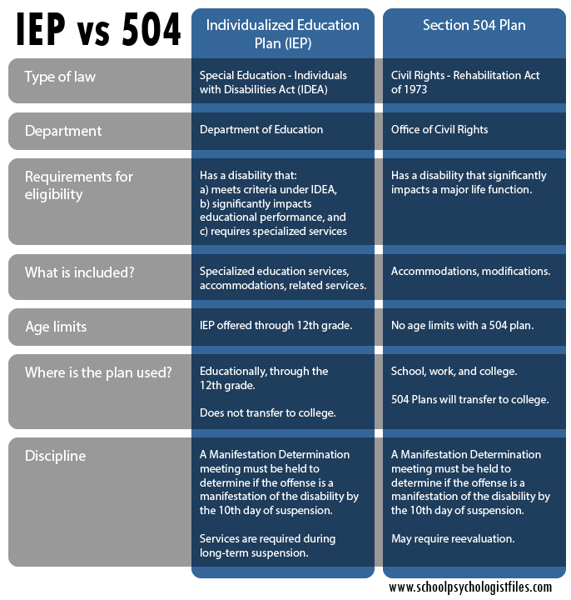
DIFFERENCES BETWEEN IEP VS 504 pLANS

Slide 13
Evaluation
School and/or parent may refer
School must seek parental consent
Must be conduct in all areas related to child’s suspected disability or disabilities
Within 90 days of receipt of a written referral
Evaluations
Eligibility determination
IEP developed (for eligible child)
Placement completed (for eligible child)
Eligibility determined by parent and group of qualified professionals (typically IEP Team)
Must be done at least every 3 years, unless school and parent agree not necessary
If parent or eligible student disagrees, has right to free, independent educational evaluation

Slide 14
IEP Team
Parents
At least one regulation education teacher of the child
At least one special education teacher of the child
Representative of district who’s
Qualified to provide, or supervise the provision of, specially designed instruction to meet the unique needs of children with disabilities
Knowledgeable about general education curriculum
Knowledgeable about availability of resources of district
Individual who can interpret instructional implications of evaluation results
Other individuals who have knowledge or special expertise regarding the child
E.g., psychologist, counselor, social worker, doctor, etc.
Child (when appropriate)

Slide 15
Individualized Education Program (IEP)
Present levels of academic achievement and functional performance
Measurable annual goals and how goals will be measured
Special education and related services
When begin, how often provided, where provided, and how long will last
Accommodations
Placement: Extent (if any) to which child will not participate with nondisabled children in regular class and other school activities
Must be least restrictive environment (see next slide)
Any modifications or exemptions from state- and district-wide tests
Transition services (after child turns 14)
Must be reviewed at least once/year

Slide 16
Measurable IEP Goals
SMART
Specific
Measurable
Ambitious
Attainable
Realistic
Time-bound
PLAAFP
It is through the PLAAFPs that you will
identify and prioritize the specific needs of the child
establish baseline level performance in relation to the general curriculum academic standards in order to develop an individualized and meaningful plan, and
identify the degree of match between skills of the child and the instructional environment for the purpose of guiding decision making.

Slide 17
Least Restrictive Environment (LRE)
Students must be educated, to maximum extent possible, alongside non-special-education students
Team decision
Options:
Separate: ≤39% w/ non-disabled peers
Resource: 40-79% w/ non-disabled peers
Regular: ≥ 80% w/ non-disabled peers
Other
Special schools
Home instruction
Instruction in hospitals and institutions

Slide 18
Extended school year
Whether the student regresses or may regress during extended breaks from instruction and cannot relearn the lost skills within a reasonable time; or
Whether the benefits a student gains during the regular school year will be significantly jeopardized if he or she is not provided with an educational program during extended breaks from instruction; or
Whether the student is demonstrating emerging critical skill acquisition (“window of opportunity”) that will be lost without the provision of an educational program during extended breaks from instruction.

Slide 19
School-to-Prison Pipeline: Definition
A system of laws, policies, and practices that pushes students out of schools and into the juvenile and criminal justice systems
School-to-Prison Pipeline

Slide 20
Manifestation Determination Review (MDR)
If child suspended facing > 10 school days in one school year, must be IEP Team meeting to determine if conduct was:
Caused by, or had a direct and substantial relationship to, the child’s disability; or
Direct result of school’s failure to implement the IEP
If answer to either is yes, child can’t be suspended
Exceptions for drugs, weapons, and serious injury
If answer to #1 is yes, school must:
Conduct Functional Behavioral Assessment (FBA); and
Create Behavioral Intervention Plan (BIP)
If answer to both is no, child can be suspended, but must continue to receive FAPE

Slide 21
Protections for Students Not Yet Eligible for Special Education
Students who have not yet been identified as being eligible for special education may nonetheless assert school discipline-related protections under IDEA if the school had a basis of knowledge that the child was a child with a disability before the suspension occurred.
Basis of knowledge =
Parent/guardian expressed written concern that the child was a student with a disability in need of special education;
Parent/guardian requested a special education evaluation;
Teacher or other school staff expressed specific concerns about a pattern of behavior to the director of special education or other administrator; or
Based on behavior and academic performance, clear and convincing

Slide 22
Handling Disputes
Request all of your child’s education records;
Request independent education evaluations;
Decide on filing a state complaint, OCR complaint, or due process petition.

Slide 23
Red flags
Procedural
Substantive
Dated Evaluations
Missing mandated evaluations
Behaviors but no FBA and BIP
Native language rights not honored
IEP team composition
IEP not being implement
Transition plan missing
Home instruction
Suspensions and removals
Child find
Predetermination
Lack of toilet training
Lack of implementation of related services

Slide 24
QUESTIONS!!!

Slide 25
Contact Information
Attorney Keith Howard
The Law Offices of Keith L. Howard, Esq.
Phone: 704-612-4151
Email: keithh@khowardlaw.com

